Slide 1


Welcome to English
Introductions, Verb 'Be', and More

Slide 2

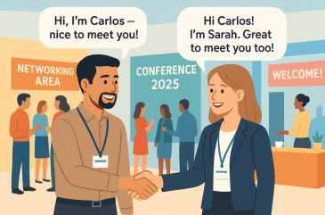

Key Vocabulary
Nationality
The country you are from or where you have citizenship. For example, if you are from Mexico, your nationality is Mexican.
Contraction
A shorter form of a word or group of words. For example, 'we are' becomes 'we’re'. Contractions make speech and writing more natural.

Slide 3
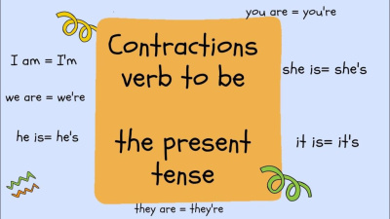
The Verb 'Be': Basics
What is the verb 'be'?
'Be' is one of the most common verbs in English.
It helps us talk about who we are, where we are from, and how we feel.
Examples:
I am a student. → I'm a student.
You are from Brazil.
She is happy.

Slide 4
Pronouns and the Verb 'Be'
Subject Pronouns
I
You
He / She / It
We
They
These words replace names in sentences.
Verb 'Be' Forms
am (with I)
are (with you, we, they)
is (with he, she, it)
Example:
You are a teacher.
They are students.

Slide 5



Forming Questions with 'Be'
Step 1
Start with the verb 'be' (am, is, are).
Step 2
Add the subject after the verb.
Step 3
Finish with the rest of the sentence.
Example:
Are you from Mexico?

Slide 6

Positive and Negative Answers
Saying Yes
Repeat the subject and the verb.
Example: Are you a student? Yes, I am.
Saying No
Add 'not' to the verb.
Example: Are you a teacher? No, I am not.
Contractions
To sound more natural, use contractions: 'I am not' → 'I'm not', 'You are not' → 'You aren't'.

Slide 7

Pronouns, 'Be', and Contractions
Question 1:
Which form of the verb 'be' do we use with the pronoun 'she'?
Question 2:
How do you form a contraction for 'we are'?
Question 3:
When you answer 'no' to the question 'Are you from the United States?', how can you use a contraction in your answer?
Answers on the next slide...

Slide 8
Pronouns, 'Be', and Contractions
​✅​
Answer 1:
We use 'is' with the pronoun 'she'.
Answer 2:
The contraction for 'we are' is 'we're', which is a shorter way to say the words.
Answer 3:
You can say 'No, I'm not' as a contracted negative answer.

Slide 9
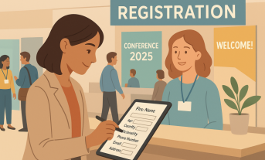

Describing Yourself
Write your first and last name.
Write your age and country.
Write your nationality.
Example:
My name is Maria Garcia.
I am 25 years old.
I am from Mexico. I am Mexican.

Slide 10

Fill in the blanks ​🧩​
I ____ from Mexico. I ____ Mexican. My ____ is Alex Jones.
Word bank ​🏦​
am, name, are, he, country, am
Answers on the next slide...

Slide 11
Fill in the blanks ​🧩​
​✅​
I am from Mexico. I am Mexican. My name is Alex Jones.
Word bank ​🏦​
am, name, are, he, country, am

Slide 12

Summary: You Did It!
What You Learned
How to use the verb 'be' in sentences and questions.
How to answer positively and negatively, with and without contractions.
How to describe yourself: name, age, country, and nationality.
Keep practicing! The more you use English, the easier it gets.
Welcome to English! © 2025 by Joe Ehman is licensed under Creative Commons Attribution-NonCommercial-ShareAlike 4.0 International

