Slide 1


Question Tags 5: Negative Words and Meanings
Mastering Hidden Negatives in English Question Tags

Slide 2

Key Vocabulary
NEVER
HARDLY
SELDOM
FEW
At no time; not ever. Example: She never eats meat.
Almost not; barely. Example: He hardly speaks in class.
Not often; rarely. Example: We seldom travel in winter.
Not many (countable); almost none. Example: Few people attended.

Slide 3



More Key Vocabulary
little
Not much (uncountable); almost none. Example: There is little hope.
a few
Some (countable); a small number, but more than none. Example: A few students stayed.
a little
Some (uncountable); a small amount. Example: I need a little sugar.

Slide 4
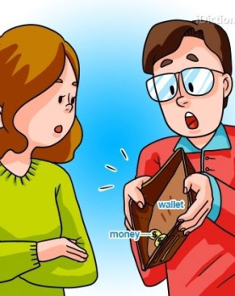
Negative Words Without 'Not'
Hidden Negatives
Words like never, hardly, seldom, rarely, scarcely, barely, few, and little imply negativity. Though seemingly neutral, their presence requires a positive question tag, even without an explicit "not."

Slide 5


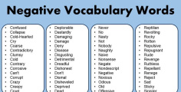
Negative Polarity Words
1
2
3
Never
Means 'not ever.' Tag must be positive. Example: He never calls, does he?
Hardly/Seldom
Mean 'almost not' or 'rarely.' Tag must be positive. Example: She hardly eats, does she?
Few/Little
Mean 'not many' or 'not much.' Tag must be positive. Example: Few people came, did they?

Slide 6

Spanish vs. English Tags
Spanish
Double negatives common: Nunca estudia, ¿verdad?
Tag unchanged.
English
Double negatives incorrect: 'He never studies, doesn't he?' ​❌​
Tag flips: 'He never studies, does he?' ​✔️​
Key Difference
Spanish learners often make mistakes with English tags because of this difference. English tracks the hidden negative meaning closely.

Slide 7
A Few vs. Few: Big Difference!
Tiny Words, Big Meaning Shift
Few = Almost none (negative)
A few = Some (positive)
Examples:
Few students passed, did they? (Negative meaning)
A few students passed, didn't they? (Positive meaning)
Tip: Adding 'a' flips the meaning and the tag polarity.

Slide 8
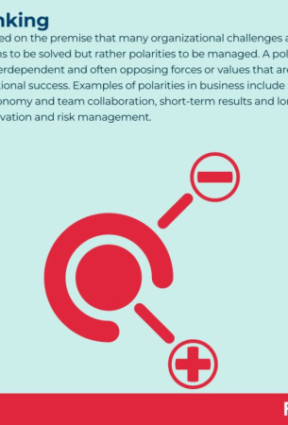
Quick Guide: Tag Polarity
1
Never/Hardly/Few
Negative meaning, so the tag is positive. Example: She never calls, does she?
2
A Few/A Little
Positive meaning, so the tag is negative. Example: A little sugar helps, doesn't it?

Slide 9

Hidden Negatives Quiz
Question 1:
If a sentence contains the word 'hardly,' should the question tag be positive or negative? For example, 'He hardly ever smiles, does he?' or 'He hardly ever smiles, doesn't he?'
Question 2:
Complete the following sentence with the correct question tag, explaining why: 'Few people attended the meeting, _________?'
Question 3:
Which sentence correctly uses a question tag and why: 'She has a little money, doesn't she?' or 'She has a little money, does she?'
Answers on the next slide...

Slide 10
Hidden Negatives Quiz
​✅​
Answer 1:
The tag should be positive; 'hardly' implies a negative meaning, so 'He hardly ever smiles, does he?' is correct.
Answer 2:
The correct tag is 'did they?' because 'few' indicates a negative quantity, requiring a positive tag.
Answer 3:
'She has a little money, doesn't she?' is correct because 'a little' signifies a small, positive amount, thus needing a negative tag.

Slide 11
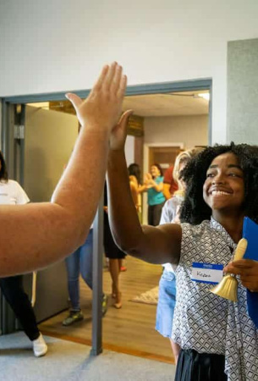
Summary: Mastering Hidden Negatives
Key Takeaways
Words like never, hardly, few, little carry negative meaning, even without 'not'.
After these, use a positive question tag.
Adding 'a' (a few, a little) flips the meaning to positive, so the tag becomes negative.
Mastering these shifts is a sign of advanced fluency.
Challenge yourself: Spot hidden negatives in real conversations and use the correct tag!

Slide 12
Common Mistakes Review
1. Double negatives: Don't add 'not' in the tag after hidden negative words (e.g., never, hardly).
2. Mixing up 'few' and 'a few': 'Few' is negative; 'a few' is positive, so check your tag!
3. Ignoring hidden negatives: Even when you don't see 'not', words like 'little' still need a positive tag.
Correct: "He seldom visits, does he?" NOT "He seldom visits, doesn't he?"

Slide 13

​✨​ ¿Aún no eres estudiante de
Inglés con Joe? ¡Esta es tu oportunidad! ​✨​
En solo unos minutos puedes:
​🎓​ Descubrir tu nivel real de inglés con nuestro examen de ubicación GRATIS
​📄​ Recibir un certificado que demuestra tu nivel
​🎁​ Reclamar una semana de clases en línea GRATIS adaptadas a ti
​✅​ ¡Completa el examen y toca el botón de WhatsApp que aparece con tus resultados para obtener tu semana gratis!
inglesconjoe.com WhatsApp: 81 81 13 53 67

