Slide 1



Negative Statements, Positive Tags
Mastering English Question Tag Polarity for Fluency

Slide 2

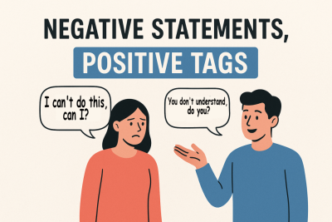
Learning Objectives
By the end of this lesson, you will:
Understand how negative statements use positive tags in English.
Avoid common double negative errors influenced by Spanish.
Identify the correct auxiliary and subject for tags.
Apply the rule to real-life conversations and writing.

Slide 3




Key Vocabulary
Clause
A group of words with a subject and a verb. It can be a full sentence or part of one.
Tag
A short question at the end of a statement to check or confirm information.
Polarity
Positive/negative statements: Grammar shows if something is denied or affirmed.
Auxiliary
A helping verb (like do, have, be, can) used to form questions and negatives.

Slide 4
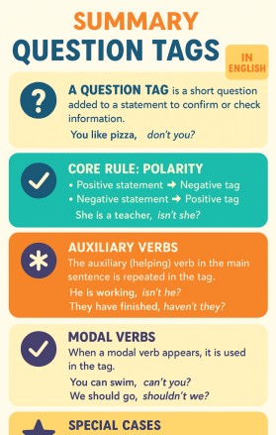
The Standard Rule
Negative Statement → Positive Tag
When the main clause is negative, the question tag must be positive.
Example:
She isn't ready, is she?
This is a key marker of fluent English. Using a negative tag after a negative statement is a classic learner error.

Slide 5


Why Does Polarity Flip?
The tag acts like a confirmation check.
If the main clause is negative, the tag flips to positive to seek agreement.
Example:
He didn't come, did he?
A double negative in English sounds illogical and confusing.

Slide 6
English vs. Spanish
Spanish Allows Double Negatives
In Spanish, both the clause and the tag can be negative: No vino, ¿no?
English Requires One Negative
In English, only ONE negative is allowed between the clause and the tag. Double negatives are not standard and sound confusing to native speakers.
Now, let’s compare with Spanish. In Spanish, you can use a double negative, like “Él no vino, ¿no?” That feels natural in Spanish. But in English, only one negative is allowed.
So remember:
​❌​ She didn’t eat, didn’t she?
​✅​ She didn’t eat, did she?

Slide 7
Step-by-Step: Making a Tag
1
2
4
Check Polarity
If the clause is negative, the tag must be positive.
Form the Tag
Combine auxiliary and subject to create the positive tag.
3
Find Auxiliary
Identify the auxiliary verb in the main clause (like don't, can't, haven't).
Repeat Subject
Use the same subject in the tag as in the main clause.

Slide 8
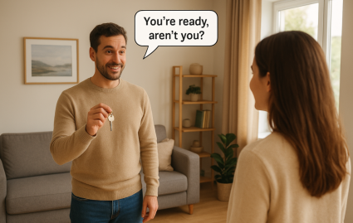
Examples in Action
Correct Tag Polarity
They aren't coming tonight, are they?
He didn't finish his homework, did he?
We haven't met before, have we?
She can't drive, can she?
You won't forget, will you?
Notice how each negative clause is followed by a positive tag.

Slide 9

Positive Tags Practice
Question 1:
What kind of tag (positive or negative) should follow a negative statement in English?
Question 2:
The sentence 'You aren't from around here, aren't you?' contains a common error. What is the correct positive tag for this statement?
Question 3:
Complete the following statement with the correct positive tag: 'She doesn't speak French, ____?'
Answers on the next slide...

Slide 10
Positive Tags Practice
​✅​
Answer 1:
A positive tag should always follow a negative statement in English to avoid double negatives.
Answer 2:
The correct positive tag is 'are you?', making the sentence 'You aren't from around here, are you?'
Answer 3:
The correct positive tag is 'does she?', completing the statement as 'She doesn't speak French, does she?'

Slide 11

Summary: Key Takeaways
Remember!
Negative clause → Positive tag
Only one negative between clause and tag in English
Avoid double negatives, even if it feels natural in Spanish
Using the right polarity is a powerful marker of fluency
Practice makes perfect—keep listening and using real English!

Slide 12



