Slide 1


Tag Questions Part 1
Mastering the Basics of English Question Tags

Slide 2


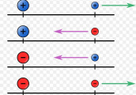
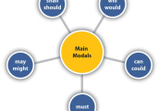

Key Vocabulary
Modal
A type of auxiliary verb that shows ability, possibility, or necessity. Examples: can, should, must.
Polarity
Describes whether a statement is positive or negative. Example: 'She is here' (positive), 'She isn’t here' (negative).
Auxiliary
Helping verbs assist main verbs to show tense, mood, or voice (e.g., is, have, will).
Main Verb
Main verb: shows action/state in a sentence (e.g., eat, run, read).

Slide 3
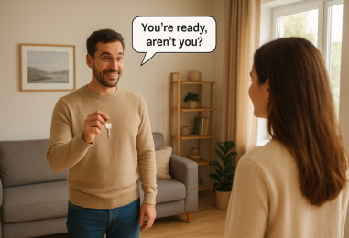
What Is a Question Tag?
The Basics
A question tag is a short question added to the end of a statement. It turns a sentence into a quick check or confirmation.
Example:
You’re a student, aren’t you?
It’s cold today, isn’t it?
Question tags help keep conversations flowing and make your speech sound natural in English.

Slide 4
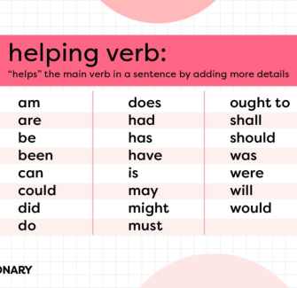
The Role of Auxiliary Verbs
The Engine of the Tag
Auxiliary verbs (like be, have, and modals) are the backbone of question tags. They show tense, mood, or voice and help structure the tag.
Without the right auxiliary, your tag won’t work!
Example:
She is studying, isn’t she?
They have finished, haven’t they?

Slide 5
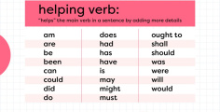
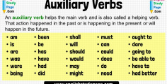
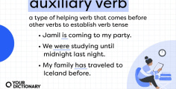
Common Auxiliary Families
1
2
3
The 'Be' Family
Includes: am, is, are, was, were. Use them if they appear in the main sentence. Ex: He was late, wasn't he?
The 'Have' Family
Includes: have, has, had. Used for perfect tenses. Example: She has seen it, hasn’t she?
Modals
Includes: can, will, should, must, etc. Always use the same modal in the tag. Example: You can swim, can’t you?

Slide 6

Main Verb or Auxiliary?
Don’t Get Confused!
Auxiliary verbs help another verb (She is running), but sometimes they’re the only verb (She is a doctor).
Tip: Whether it’s helping or alone, use it for the tag!
She is running, isn’t she?
She is a doctor, isn’t she?

Slide 7

When to Use Do/Does/Did
If There’s No Auxiliary...
Use do, does, or did in the question tag when the main verb isn’t an auxiliary or modal.
Present Simple: I/you/we/they → do; he/she/it → does
Past Simple: All subjects → did
Examples:
You like coffee, don’t you?
She sings, doesn’t she?
They left, didn’t they?

Slide 8

Positive and Negative Tags
Positive Statement
Use a negative tag.
You play tennis, don’t you?
Negative Statement
Use a positive tag.
You don’t play tennis, do you?

Slide 9

Fill in the blanks ​🧩​
If a statement is positive, the question tag is ____, and if a statement is negative, the question tag is ____.
Word bank ​🏦​
positive, auxiliary, neutral, negative
Answers on the next slide...

Slide 10
Fill in the blanks ​🧩​
​✅​
If a statement is positive, the question tag is negative, and if a statement is negative, the question tag is positive.
Word bank ​🏦​
positive, auxiliary, neutral, negative

Slide 11

Summary: Key Takeaways
Review What You Learned
Identify the auxiliary or main verb for your tag.
Use the correct pronoun and match the subject.
Remember the polarity rule: positive statement → negative tag; negative statement → positive tag.
Practice makes perfect—keep using question tags in real conversations!

Slide 12


