Slide 1

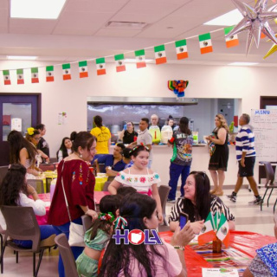
English for Social and Community Interactions
Building Everyday Skills for Community Connections

Slide 2

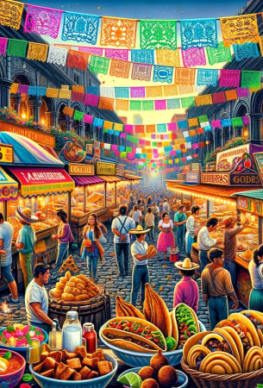
Learning Goals
Understand and use common greetings, introductions, and polite phrases in written English.
Read and interpret texts about family, daily routines, and Mexican traditions.
Comprehend written texts for community scenarios, such as shopping or event invitations.
Recognize and express opinions and preferences in culturally relevant situations.
Strengthen reading skills for real-life social and community interactions.

Slide 3
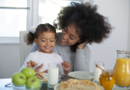

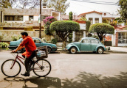

Key Vocabulary
Routine
The usual way of doing things every day, like habits or daily activities.
Greeting
A polite word or action when you meet someone, like 'Hello' or 'Good morning.'
Community
A group of people living in the same place or sharing common interests.
Introduction
Introduce yourself with your name and a brief personal detail when meeting.

Slide 4
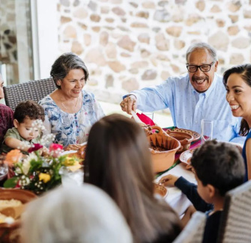
Greetings and Introductions
Making Connections
In Mexican social settings, greetings are important! Written greetings can be formal or informal:
Formal: 'Good morning, how are you?'
Informal: 'Hi!'
Example
'Hello, my name is Ana. Nice to meet you.'
Cultural Tip
A polite greeting shows respect and friendliness.

Slide 5
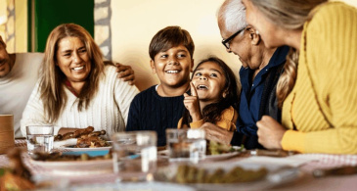
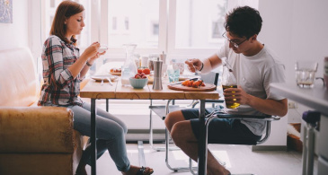
Family and Daily Life
Family is central in Mexican culture. Written texts often mention mothers, siblings, and cousins.
Example: 'My brother goes to work every day.'
Daily routines use the present simple: 'I eat breakfast. I go to school.'
Possessive adjectives show who something belongs to: 'This is my house.'

Slide 6
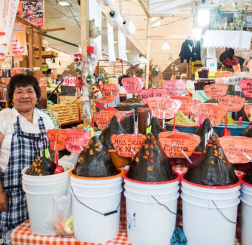
Shopping at the Mercado
Mercado Language
Shopping at a local market uses special phrases:
'How much is this?'
'Do you sell avocados?'
Numbers and food words are common: 'The price is 20 pesos.'
Cultural Note
Mercados are lively places for buying, selling, and bargaining in Mexican communities.

Slide 7
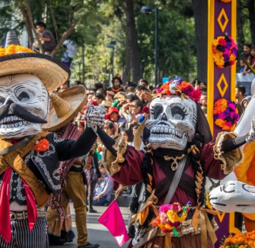
Traditions and Fiestas
Celebrating Together
Written texts may describe holidays like Día de los Muertos or Independence Day.
Example: 'Last year, I went to a parade. The fiesta was very fun.'
Past simple verbs (went, was, made) help tell about events from before.

Slide 8
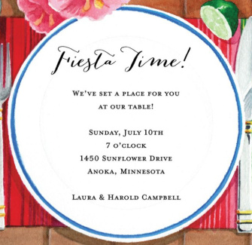
Invitations and Plans
Making Plans in Writing
Invitations often use polite phrases:
'Would you like to come?'
'We can meet at 5 p.m.'
Future plans use 'going to': 'I am going to the party tomorrow.'
Formal and casual tones are both used in Mexican invitations.

Slide 9
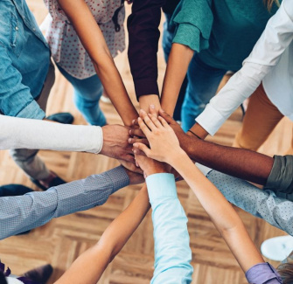
Expressing Opinions and Requests
Sharing Your Thoughts
Phrases like 'I think...' or 'In my opinion...' show opinions in writing.
To ask for help or apologize:
'Can you help me?'
'I'm sorry for being late.'
Being polite is important in Mexican written communication.

Slide 10
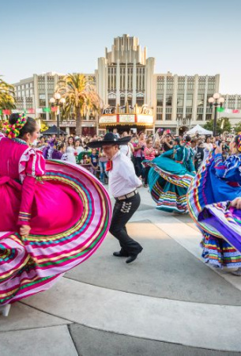
Summary: Building Community in English
You learned how to:
Use greetings, introductions, and polite phrases
Read about family, routines, and traditions
Understand shopping and fiesta texts
Express opinions and make requests in writing
These skills help you connect with your community and understand real-life texts in English.

Slide 11



