Slide 1


There is_____. Is there____?

Slide 2

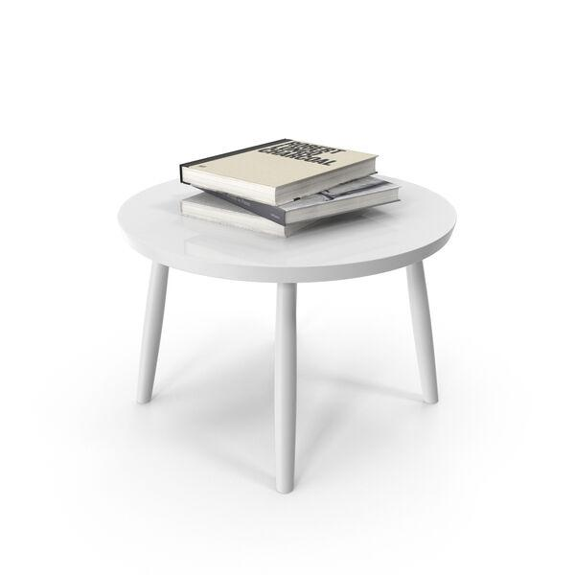
What Does 'There is' Mean?
Understanding 'There is'
'There is' is used to state that something exists or is present in a place.
It helps describe what you see or notice around you.
Example: There is a book on the table.
Use 'There are' for plural nouns: There are three chairs in the room.

Slide 3
How to Form Questions: 'Is there...?'
Structure
Start with Is there for singular nouns.
For plural, use Are there.
Add the object and location.
Example:
Is there a restroom nearby?
Example:
Are there any apples in the fridge?
When to Use It
To ask if something exists or is available.
Useful in daily life: restaurants, stores, travel, and more.
Example:
Is there a bus stop on this street?
Example:
Are there any messages for me?

Slide 4
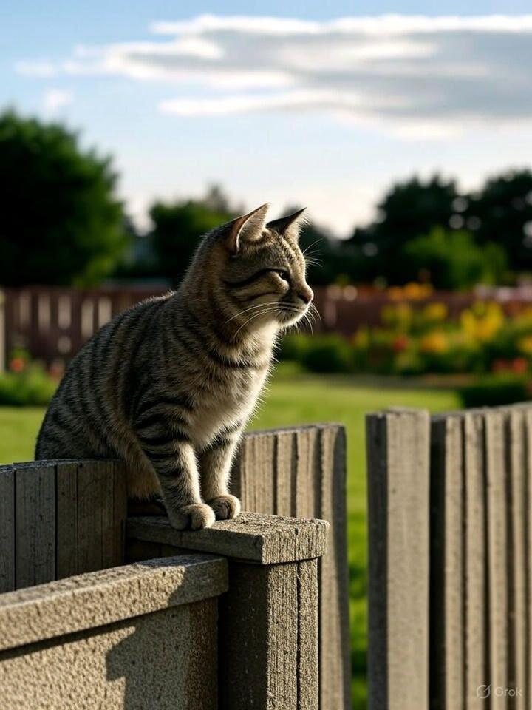
Comparing: 'There is' vs. 'Is there?'
Statement
There is a cat outside.
Question
Is there a cat outside?
Plural
Are there any cats outside?

Slide 5

Real-Life Situations
Everyday Examples
At a hotel: Is there Wi-Fi in the room?
At work: There is a meeting at ​2​ PM.
At a store: Are there any discounts today?
These phrases help you communicate clearly in new places or situations.

Slide 6
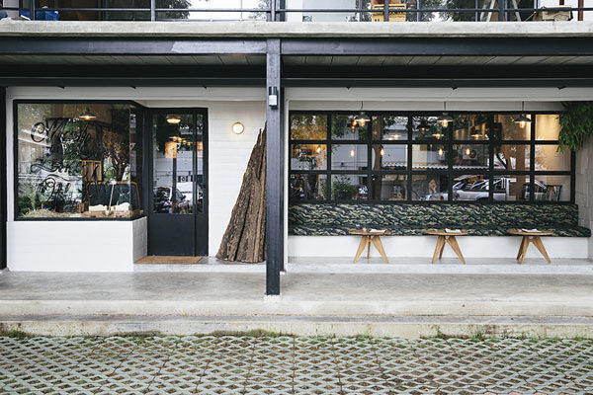

Practice: Making Sentences
There is a coffee shop on Main Street.
Is there a coffee shop on Main Street?

Slide 7

Fill in the blanks ​🧩​
____ a new student in our class today. ____ any questions?
Word bank ​🏦​
There are, Is there, Are there, There is
Answers on the next slide...

Slide 8
Fill in the blanks ​🧩​
​✅​
There is a new student in our class today. Are there any questions?
Word bank ​🏦​
There are, Is there, Are there, There is

Slide 9

Tips: Common Mistakes to Avoid
Watch Out For:
Using 'is' with plural nouns (Incorrect: There is many books.)
Forgetting to invert for questions (Incorrect: There is a bank nearby?)
Not matching the verb with the noun (Correct: Are there any problems?)
Tip: Always check if the noun is singular or plural!

Slide 10

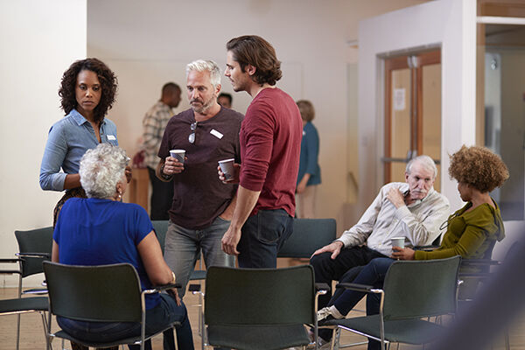
Discuss! ​🤷​‍​♀​️ ​💁​‍​♂​️ ​💬​
Neighborhood Exploration
Think about your neighborhood. What is there? What isn't there? Ask your classmates questions using 'Is there...?' and answer.

Slide 11
Discuss! ​🤷​‍​♀​️ ​💁​‍​♂​️ ​💬​
​✅​
You might have said...
There is a park near my house.
There isn't a grocery store close by.
Is there a coffee shop in your neighborhood? Yes, there is.

Slide 12
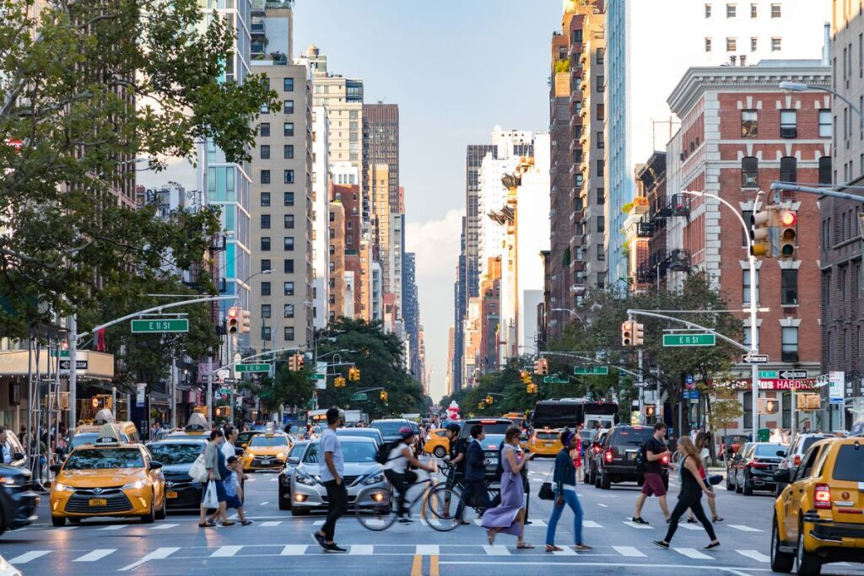
Summary: Using 'There is' and 'Is there?'
Key Takeaways
Use 'There is/are' to state that something exists.
Use 'Is there/Are there' to ask if something exists.
Remember to match singular/plural nouns.
These structures are useful in daily conversations, at work, and while traveling.
Practice these phrases to feel more confident in English!

