Slide 1


Simple Future: Will & Going to
Mastering Future Tense for Everyday English

Slide 2


Introduction to the Simple Future
Why Do We Talk About the Future?
We use the simple future tense to discuss things that have not happened yet but will happen later.
Two Common Ways
Will
Going to
Both forms help us express predictions, plans, promises, and decisions. Understanding when to use each is key to sounding natural in English!

Slide 3



Forming the Simple Future
Will + base verb
I will study.
Be going to + base verb
She is going to travel.
Negative & Questions
Will you help? I’m not going to eat.

Slide 4
When to Use 'Will'
​1​. Instant Decisions
You decide something at the moment of speaking.
"I'm thirsty. I will get some water."
​2​. Promises & Offers
You promise or offer to do something.
"Don’t worry, I will pay you tomorrow."
​3​. Predictions (No Evidence)
You think something will happen, but you have no proof.
"I think it will rain tomorrow."
​4​. Future Facts
Talking about facts or things that are always true in the future.
"The sun will rise at ​6​ am."

Slide 5


When to Use 'Going to'
Planned actions
I’m going to visit my friend.
Predictions (with evidence)
Look at those clouds! It’s going to rain.

Slide 6


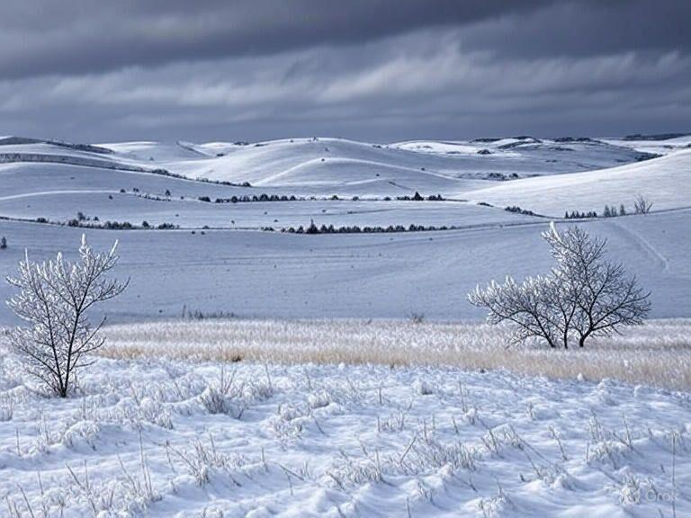
Real-World Examples
At Work
"I will email you the report."
Quick decision or promise.
With Friends
"We’re going to see a movie on Friday."
A plan made before.
Weather Forecast
"It’s going to snow tonight."
Prediction based on evidence.

Slide 7

Fill in the blanks ​🧩​
I'm so tired. I think I ____ ____ ____ a nap.
Word bank ​🏦​
to take, am, to go, will, going, take
Answers on the next slide...

Slide 8
Fill in the blanks ​🧩​
​✅​
I'm so tired. I think I amgoingto take a nap.
Word bank ​🏦​
to take, am, to go, will, going, take

Slide 9

Future Forms Quiz
Question ​1​:
Imagine you are at a restaurant and decide to order chicken. What future form would you use?
Question ​2​:
Your friend looks sad and tells you they have a lot of homework. You want to offer help. What future form is best?
Question ​3​:
Look outside the window. If you see very dark clouds gathering, what future form would you use to describe what might happen next?
Answers on the next slide...

Slide 10
Future Forms Quiz
​✅​
Answer ​1​:
You would say, "I will have the chicken," because it's an instant decision made at the moment.
Answer ​2​:
You should use "I will help you," as 'will' is used for promises and offers.
Answer ​3​:
You would say, "It's going to rain," because 'going to' is used for predictions based on present evidence.

Slide 11
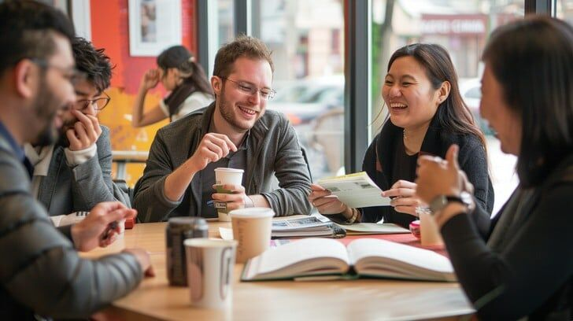
Summary: Will & Going to
You now know how to use 'will' and 'going to' to talk about the future!
Will: instant decisions, promises, predictions without evidence
Going to: plans, predictions with evidence
Practice using both forms in your daily conversations. The more you use them, the more natural they will feel!

